Slide 1
Money Max Account Presentation
Notes:
Thank you for joining us. I want to respect your time so we will start on time and end on time. A few housekeeping items before we begin:
Everyone is muted to ensure that we can get through the presentation in a timely manner and so that there is no background noise
We do want to take questions though! We are going to do that through the chat box. If you hover either at the top or bottom of your computer screen, you will see a green box that says “Chat.” You can click that and type your question. All questions will only go to the hosts for privacy purposes and we will read those and answer them at the end of this call.
Lastly, we do NOT need a video portion of this call.
Hopefully everyone who is on this call knows a little bit about Worth Unlimited and the Worth Account- at least you have heard something along the lines of “This is a software program that helps to pay off all your debts in as little as 5-7 years without any refinancing or debt consolidation, and no change to your current lifestyle.” We are going to get into the specifics of that today. But first, lets start with a bit of history about the company and where we began.

Slide 2
Our Story
1997 Started a Mortgage Company
Founded by Skyler Witman and John Washenko
One of Utah’s fastest growing companies in 3 years
2002 Focused on Finding a Cure for Clients
Began to create a program to help homeowners rapidly pay off mortgages
2004 Launched 1st Version of the Money Max Account
Award Winning Debt Elimination Software
2005-2006 Denver Beta Test
400 homeowners
Averaged 20% ahead of schedule
Notes:
In 1997, Skyer Witman and John Washenko started a mortgage company. It was one of Utah’s fastest growing companies over a 3 year period. However, they began seeing their clients come back to them 3-5 years later and they had more debt than before. They were getting themselves deeper and deeper into debt. Skyler and John had been childhood friends and both experienced their homes being foreclosed on as children. They saw the havoc it can cause to a family and it stirred something in them- a passion to help people get out from the bondage of debt. So in 2002, they decided to focus on a cure for clients. They hired a team of experts to begin building a program to rapidly help homeowners get out of debt. In 2004 it was ready to launch. They had great success and decide to do a beta test from 2005-2006 that included 400 homeowners in Denver, CO. What they found, was that at the end of the first year, most of the homeowners were on average, 20% ahead of their predicted payoff schedule. They new they had something that they could now take to the entire nation.

Slide 3
Our Story
2006 Launched UFirst Financial
Helped 10,000’s of people pay off mortgages in 1/2 to 1/3 the time
Every 12 Minutes a homeowner started their journey to financial freedom using the software, combined with a HELOC
Notes:
They launched Ufirst Financial in 2006 and things took off. Every 12 minutes a homeowner was starting the program and beginning their journey to financial freedom. The company was featured in numerous industry publications and even was given the Ernst & Young Entrepreneur Of The Year award for 2008 in financial services for the Utah region.
Ernst & Young doesn’t just look at a product and say, “Wow. That’s a nice idea. Let’s give them an award for that.” What Ernst & Young does is very intensive due diligence. They look at the financials of the company. They look at the longevity potential of the company. They look at customer retention. They look at the product itself for its viability in the marketplace. They want to know that the companies they look at, that they give this award to, have staying power in the marketplace, that they are not just a flash in the pan, that they are established with a good, strong business model to project future longevity and future impact on consumers.
After doing all that research and due diligence, Ernst & Young realized that these gentlemen fit their criteria and awarded them the Entrepreneur Of The Year award for 2008 in the Utah region.

Slide 4
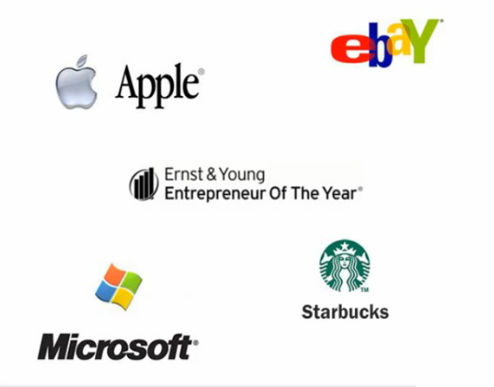
Moving in the Right Direction
Notes:
These are some of the companies who have also received the Ernst and Young Entrepreneur of the Year award.

Slide 5
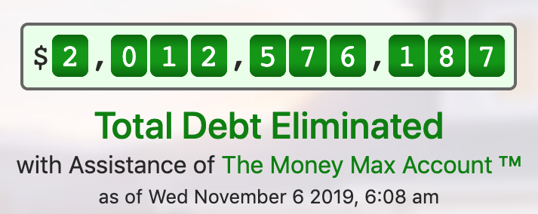
Our Story
2009 Global Financial Meltdown
Never stopped servicing clients
Continued to improve software. Eliminated reliance on HELOC
Launched additional company as UFinancial Freedom
Currently
Nearly $20 Million spent on the software
Over 70,000 clients across the US have purchased the program
Over $2 Billion of debt paid down with the assistance of the Money Max Account
Notes:
Unfortunately, 2009 we experienced the greatest financial crisis since the Great Depression- the global financial meltdown. Banks and financial institutions needed bailouts just to survive. At this time, the software program would only work in combination with a HELOC. And when lending dried up, so did the ability to market the software to the broader population. However, the company never stopped servicing their existing clients. They went back to the drawing board and began working on improving the software to eliminate the reliance on HELOC’s- and they succeeded. They relaunched as Worth Unlimited.
Currently, there has been almost $20M spent developing the software. We have 70k clients across the nation, and nearly $2B of debt has been paid down with the assistance of the Worth Account.

Slide 6
How Do Banks Work?
Why does the largest building in every city have a banks name on it?
Banks pay interest to earn interest.
Banks pay interest at <3%
Banks earn interest at >6%
Your checking, savings, cd’s
Earn <3%
Your loans, credit
cards, mortgages
pay >6%
Notes:
Now, before we get into HOW the software works, we need to have a basic understanding of banking principles and how interest works.
Have you ever wondered why in most major cities in North America a bank’s name sits atop them? How have banks build their empire. One strategy banks have used is to pay interest to make interest. Let’s take a look at how this works. Banks have multiple ways of collecting capital. Some of their main ways allow them to pay less than 3% and sometimes all the way down to 0% interest on that money they control. On the flip side banks tend to earn interest through multiple vehicles at an interest greater than 6% percent and sometimes up into the 20%+ range. Now let’s take a look at where banks can get capital at less than 3%. It comes from your checking, savings and cd’s. And on that flip side your loans, credit cards and mortgages are what pay the bank’s the greater than 6%. The difference of what we earn interest at and pay interest at is known as arbitrage. As we can see here arbitrage can work for or against you. We want to teach you to make it work for you.

Slide 7
$200,000 Principal Balance 6% Interest Rate $1,199.10 Monthly Payment
 | Principal | Interest | Balance | Equity | Paid
Month 1
Month 2
Year 1
Year 5
Year 10
Year 21
Year 30
$199.10 | $1,000.00
$1 increase
Interest Paid
$231,677
$200.10 | $999.00
81% is interest
$210.33 | $988.77 | $197,543 | $2,457 | $14,389
$267.22 | $931.88 | $186,108 | $13,891 | $71,946
21 years = breakeven
$360.44 | $838.66 | $167,371 | $32,628 | $143,891
$696.23 | $502.89 | $99,877 | $100,123 | $302,173
 |  |  |  | $431,677
Notes:
Lets take a $200,000 home, at a 6% interest rate. Our minimum monthly payment would be $1,199.10.
Month one, when we make our payment of $1,199.10, only $199.10 went towards principal. Exactly $1,000 went to pay interest.
Look at month two, our principal portion went up one dollar, to $200.10. The amount they paid in interest only came down a dollar, to $999.
At the end of year one, we have paid in over $14,000 in payments, but only $2,400 has gone to principal!
Lets go out ten years, at the end of ten years, we have paid just over $143,000 in mortgage payments, but only $32,000 has been credited to principal!
It take roughly 21 years of a 30 year mortgage to pay it half off.
At the end of 21 years, you have paid more than $300,000, your still owe about $100,000, and you have paid down the principal about $100,000.
Its crazy, you have paid over $200,000 dollars in interest.
You know that you want to buy the home, but your only option is to get a mortgage.
Amazingly, at the end of your 30 year mortgage, you have paid $431,677 dollars. The home only cost you $200,000.
You paid $231,677 in interest. You paid more in interest than you paid for the home.

Slide 8
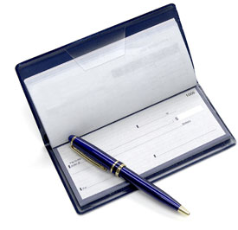
How can I pay my debt off early?
Conventional Banking
Refinance to a lower interest rate
Apply additional money to each payment
Bi-weekly payment
Money Max Account System
NO refinancing
NO change to your current standard of living
NOT a bi-weekly program
NOT a debt roll-down program
NOT a reverse mortgage
NOT a concept or theory
Notes:
Conventional Banking will tell you there are a few ways to get out of debt early. Refinance to a lower interest rate, apply additional money to each payment, or do a Bi weekly plan. Now these do work. For instance, a biweekly plan knocks 7 years off a 30 year mortgage. But we have completed flipped the script- we want to show you how to pay off a 30 year mortgage in 7 years…not just save 7 years.
With the Worth Account, there is no refinancing and no change to your current standard of living. Its not a biweekly, a debt roll down, or a reverse mortgage. Its not a concept or a theory- its fact and its proven.

Slide 9
Our System teaches you to make every dollar you make either earn interest or cancel interest!
Notes:
The Worth Account will guide you through making the money you already have and the money you continue to earn work the hardest it can for you every single day of the year. It will make your money either earn interest or cancel interest. But your money will no longer sit stagnant at the bank, helping the bank to get rich.

Slide 10
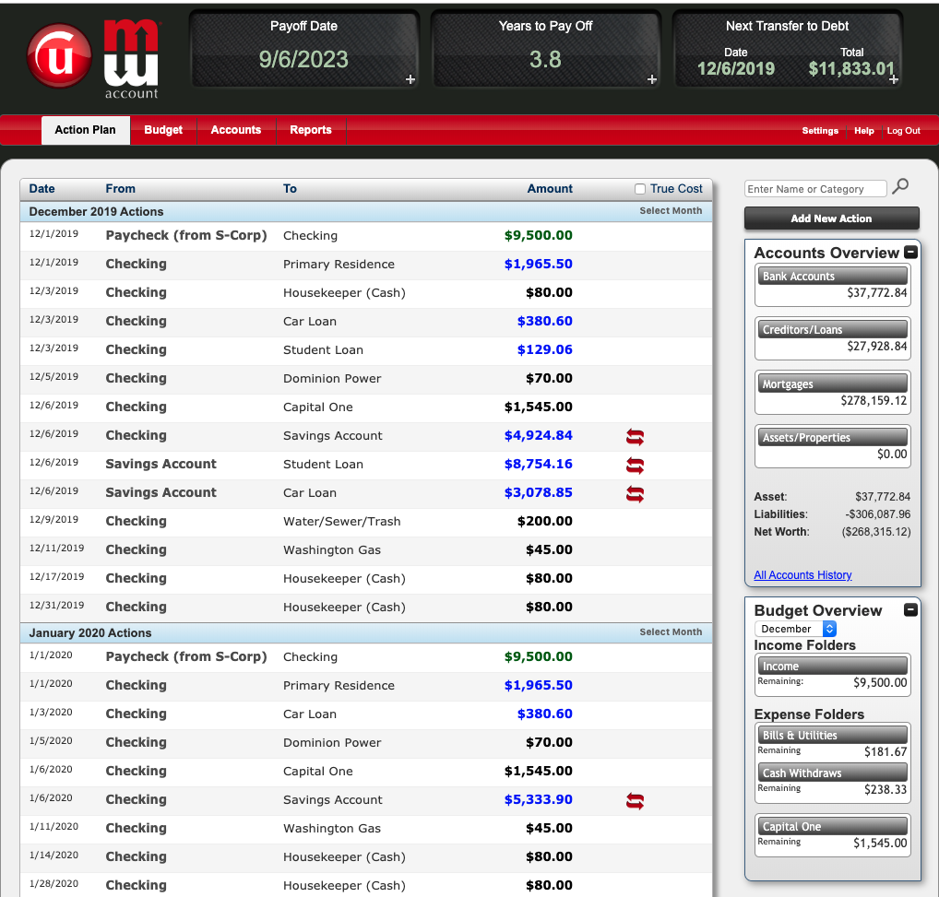
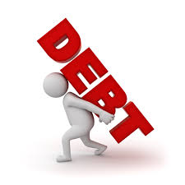
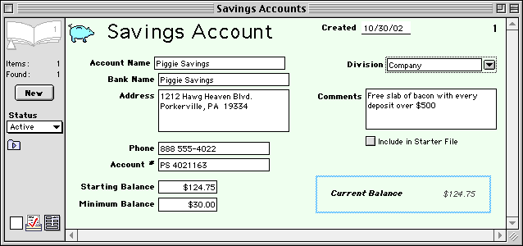
4 Required Components
Optional: Advanced Line of Credit
A Home Equity Line of Credit, Personal Line of Credit, or
even a Business Line of Credit will work, as long as it has the
correct characteristics required by the Money Max Account program
Open-End Loan
The Bank will apply money to this type of loan when received and adjust
principal balance multiple times per month.
Debt
Checking
Savings
MMA
Software &
Coaching
Notes:
The Worth Account system requires 3 components to operate. The first is your debt, which can be consumer debt, credit card debt, mortgages or a combination of all debt. Second, a checking and savings account with any banking institution. Third, the Worth Account coaching and software system. There is an optional fourth component which is an ALOC or Advanced line of credit. The ALOC can be a Home Equity Line of Credit, a personal line of credit, a business line of credit or even a credit card in some cases, with a limit of as little as $300. Having an ALOC will generally take an additional 6 months to 1 year off your payoff time.

Slide 11
4 Money Saving Principles
Interest Accumulation
Interest Float
Interest Cancellation
4. Strategic Payoff
Notes:
The Worth Account works off of 4 money saving principles that are 1. Interest Accumulation, 2. Interest Float, 3. Interest Cancellation, 4. Strategic Payoff. As we cover each of theses today in this presentation I will point them out to individually.

Slide 12
John and Rebecca Jones
Income Structure
Income | Expense | Discretionary
$5,000 | $4,800 | $200
Liability Structure
Debt | Amount | Rate | Payment | Term
Mortgage | $200,000 | 6% | $1199.10 | 360
Credit Card | $0 | 12% | $0.00 | 240
Notes:
To understand each of the money saving principles we are going to look at our example couple John And Rebecca Jones. John and Rebecca make $5000 per month net or after taxes and they spend a combined $4800 per month on all of their debts and expenses. This means John and Rebecca only have $200 worth of discretionary income per month. John and Rebecca’s liabilities include a mortgage of $200k fixed at 6% for 30 years with a principle and interest payment of $1,199.10. John and Rebecca also have a 12% credit card which they have a $0 balance on. For our example John and Rebecca are starting with no available cash in their checking and savings accounts.

Slide 13
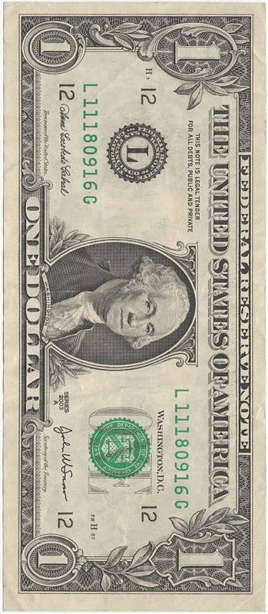
Month 1
$5,000
Notes:
On the first day of the Month they get paid $5000 that is direct deposited into their checking account.

Slide 14
Month 1
Notes:
The Worth Account System will instantly prompt them to make a transfer from their checking to their savings account so their money can start accumulating interest.

Slide 15
Month 1
Notes:
Throughout the month John And Rebecca will pay as many of their bill and expenses out of their *(Line of Credit) as they can. In many situations all bills can be paid out of a Line of Credit, so for simplicity we will use this as our example.

Slide 16
Month 2
1. Interest Accumulation
$5,000
-$199
+$12
@3%
Notes:
At the beginning of month number 2 a few things have happened I would like to point your attention to. First John and Rebecca made their first monthly payment to their mortgage resulting in a decrease of their principal balance by $199. Second their paycheck has sat in their interest bearing savings account and at 3% return has earned them $12 worth of interest. This is an example of our first money saving principle which is interest Accumulation. Next John and Rebecca receive their $5000 paycheck for month number 2.

Slide 17
Month 2
2. Interest Float
0%
Notes:
The Worth Account System will prompt them to transfer $4800 from their checking to their credit card. Has anyone ever charged some items on a credit card and then paid it off by the end of the grace period? How much interest do you pay on those charges? That’s right 0%. This is an example of our second money saving principle, Interest Float. The ability to use a banks money for free for a period of time while your money gains interest.

Slide 18
Month 2
$3,789
Notes:
Now the Worth Account system knows there is $5012 in savings and $200 in checking and has calculated for John and Rebecca that it is time to do an advanced funds transfer. An advanced funds transfer is a strategically calculated principal payment to one of your debts. This additional money comes from a combination of interest accumulation, discretionary income and interest cancellation, not from your established budgets. The Worth Account system has calculated the exact amount of $3789 to be transfer from savings to checking. This calculated amount will be different for every time and for every person. Chances are that you will never do the exact same funds transfer twice.

Slide 19
Funds Transfer
3. Interest Cancellation
Notes:
By Completing the transfer John and Rebecca Jones now have $1,223 in savings and $3989 in checking. The system will now prompt them to transfer $3989 from checking to their mortgage. This transfer is additional principal and will drastically reduce the amount of interest they are scheduled to pay on their mortgage. This is our third money saving principle, interest cancellation. Let’s take a look at how much they have saved in the first two months.

Slide 20
Interest Cancellation
$200,000 Original loan balance
$195,812 New principal loan balance
6% Interest rate
$1,199 Monthly payment
340 Months (Not 358 – Cancelled 18 months)
$231,677 Original interest paid
-$212,822 New interest paid
$18,855 Total Savings
Notes:
John and Rebecca now have a principal balance of $195,812 and are still locked at 6% interest with a payment of $1199.10 but instead of the original term of 358 more months John and Rebecca will now pay off in 340 months. That’s a reduction of 18 months and this is only the first advanced funds transfer. They were originally set to pay $231,677 in interest and now will only pay $212,822 for an interest savings of $18,855

Slide 21
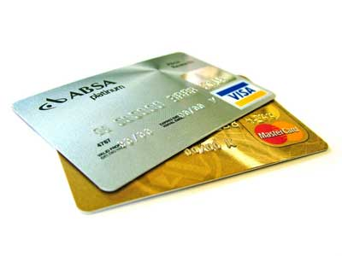
How Would you Pay this off?
120
24
1
2
6
$200,000
6%
Mortgage
$20,000
7%
Auto Loan
$10,700
7%
Student Loan
$8,000
9%
Credit Card
$4,800
12%
Credit Card
Notes:
Now so far we have kept it very basic with just a mortgage. But that is not very realistic so lets take a look at a more realistic scenario and I am going to need you response on this. If you only have 1 debt there is only 1 order to pay that debt off. But if you have 2 debts you can pay off those debts in 2 different orders. In this example John and Rebecca can pay off the mortgage first and then the student loan or they can pay off the student loan and then the mortgage. Still sounds sort of easy but did you know if you have 3 debts there are 6 different orders in which you can pay them off. With 4 debts there are 24 different orders and with 5 debts there are 120 different orders in which you can pay off those debts. Which order would you choose to pay these debts off. Did you know that even with the same interest rate there can be a better debt of two to pay off?

Slide 22
4. Strategic Payoff
Looks at the characteristics of each debt including:
Amount owed
Length of debt
Interest rate
Calculation of Payment
Adjusting Rates
Notes:
Our fourth money saving principle is strategic payoff. The Worth Account system takes into account the amount owed, length of debt, interest rate and calculation of the payment to determine which debt is the best to pay off first. It even has the ability to dynamically change based on when rates adjust on your debts.

Slide 23
John and Rebecca Jones
Conventional Program | Money Max Account System
$200,000 Starting Balance
$200,000 Starting Balance
30 years
15.6 years
$247,764 Interest Paid
$125,878 Interest Paid
$121,855 Total Interest Saved with the Money Max Account
Notes:
Utilizing the Worth Account program our example couple John and Rebecca will save $121,855 in interest. What could you do with that extra money. Take vacations, retire, spend more time with family, make investments?

Slide 24
Bank Like a Bank
CANCEL INTEREST
Computes the optimal time to leverage money
to pay off your debts and cancel interest.
Sounds simple, but it is millions of lines of code and
many different math algorithms hard at work.
Ever since banks opened their doors, they have relied on math and timing to make money work.
Now it’s your turn to bank like a bank.
Notes:
The Worth Account system allows you to start banking like a bank. It will compute the optimal time to leverage money to pay off debts and cancel interest. It may sound simple but it is millions of lines of code and many different math algorithms hard at work, 24/7.

Slide 25
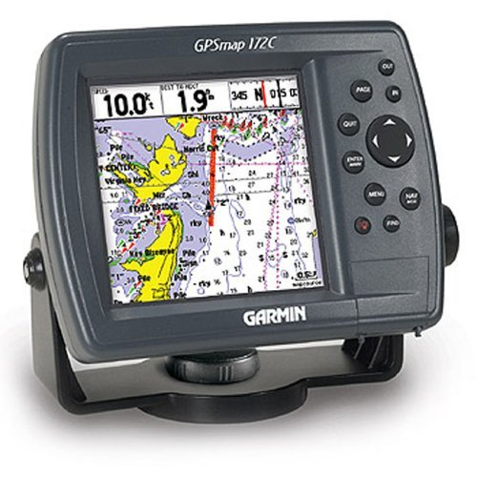
Your Financial GPS
Just like a GPS system, the MMA constantly recalibrates your game plan…taking EVERY SINGLE ASPECT of your financial situation into account:
Financial GPS
Income
Do you have multiple streams of income?
Are you commission-based?
Amount owed & term of each debt
Interest rates, including adjusting rates
Calculation of payment (types of amortization schedules)
What’s coming months down the road?
Holiday spending, family vacations, tax returns, quarterly taxes, etc.
Unexpected expenses, such as medical bills
… and then recalibrates with every change,
providing you with a TRUE FINANCIAL PLAN
Notes:
It looks at your income (Are you a dual income family, how do you get paid, weekly, biweekly monthly. Are some months better than others?) Then it looks at each of your debts, what are the balances, what are the interest rates, and do they adjust, what are the terms, how the minimum monthly payments are calculated and when they’re due. It considers all this information and using advanced banking strategies calculates mathematically the fastest way to zero for you. Then constantly recalculates when things change as they always do.

Slide 26
Your Financial GPS
It guides you to:
Pay Off Debts
Make Educated Decisions
Stay Focused
Track Success
Build Wealth
Financial GPS
Notes:
Think of the Worth Account system as your financial GPS. It guides you to paying off debts, saving for retirement, staying focused and tracking your success. At any point you can check how far you have gone, how far you have left and what your stats have been along the way.

Slide 27
The Money Max Account
Does NOT move money
Does NOT pay your bills
NO account numbers needed
No one EVER has access to your money
Functions as an account register
Wants to know how much money is coming in
Wants to know how much money is going out
Tracks and maintains your monthly budget
As little as 10 minutes per month to update
Notes:
The software does NOT move your money, it does NOT pay your bills. You have complete control over your money.
It functions as an account register, it tracks…how much money is coming in and how much money is going out. What’s coming in, and what’s going out.
It helps you track and maintain a budget. NO ONE EVER has any access to your $

Slide 28
Summary
Helps you eliminate all debt in as little as 5-7 years
Ensures you will make educated financial decisions
Helps to improve your credit score
Software is yours for life- take it from house to house
There are no mandatory monthly fees,
contracts or surprises
Lifetime customer support, coaching,
and education is available

Slide 29
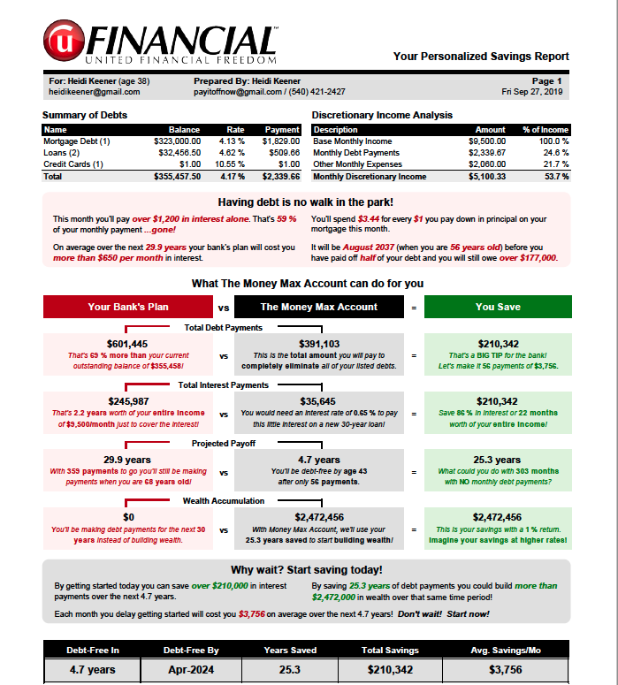
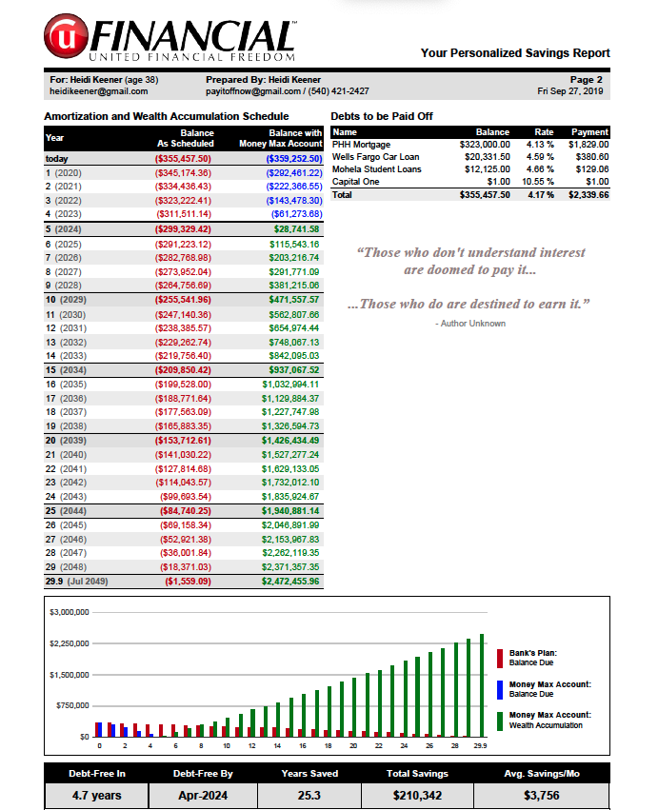
Get your Free Savings Analysis
Get the month and year you’ll be debt free!
Notes:
I love the Worth Account and what my own program has accomplished for me. Get with the person who introduced you to the Worth Account to receive your free software analysis.

