Slide 1
“The Biggest and Best Year Ever”
“Buying America Back One Family at a Time”

Slide 2
United Financial Freedom
Money Max Account Presentation
“Buying America Back One Family at a Time”

Slide 3
Our History
Started in the Mortgage Industry in 1997
One of Utah’s Fastest Growing Companies for 3 Years
Realized Significance of America’s Problem with Debt
Launched First Version of the Program in 2004
Beta Test 2005 & 2006
400 Homeowners… Average Client…
20% Ahead of Schedule
Over 70,000 Clients Nationwide

Slide 4
Disruptive Technology

Slide 5
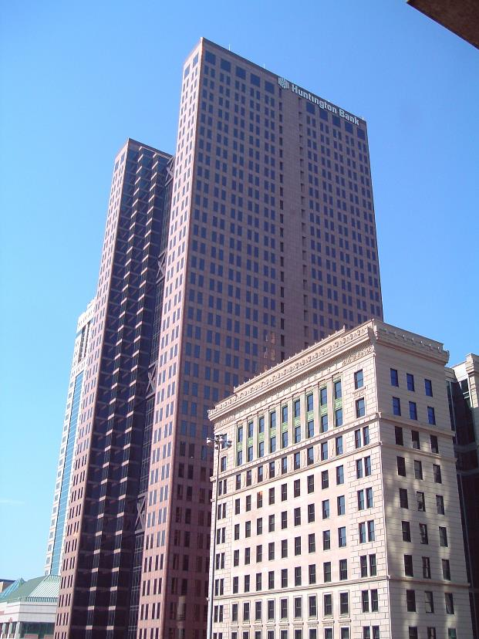
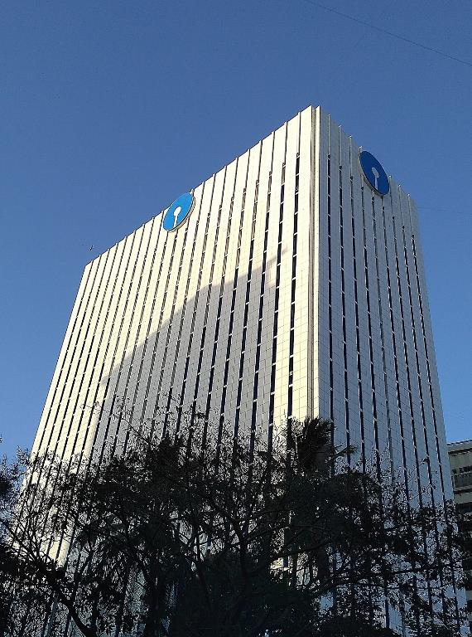
8 Banking Principles
Closed-end Loans
Interest Accumulation
Mortgage Amortization
Interest Cancellation
Open-end Credit Lines
Float & Leverage
Offset Accounts (OA)
Strategic Debt Payoff

Slide 6
# 1 - Closed-end Loans
Requires (at minimum) a Full-Scheduled Payment
Allows payment IN… No Withdrawals
Driven by an Amortization Schedule
Any money applied does not effect Interest charges until the Following Month
Calculates interest charges from the Month-End Principal Balance

Slide 7
# 2 - Interest Accumulation
Principal loan amt:
Interest rate:
Monthly pmt:
Months (30-yrs):
Total repayment:
Principal loan amt:
Total interest paid:
$200,000
6%
$1,199
x 360
$431,677
$200,000
$231,677
“Real” cost of our $200,000 Home…
$ 431,677

Slide 8
#3 – Mortgage Amortization
Based on $200,000 - 6% Interest Rate – 360 Months Term
 | Principal | 6% Interest | Balance | Equity | Paid
Month 1
Month 2
Year 1
Year 5
Year 10
Year 21
Year 30
$199.10
$1,000
83% Interest
$1 Difference
$200.10
$999
$210.33
$988.77
$197,544
$2,456
$14,389
$267.22
$58,055 Interest
$13,891
$71,946
$931.88
$186,108
$360.44
$838.66
$167,371
$32,628
$143,892
Half-way mark
$99,877
$302,173
$696.23
$502.87
$100,122
115%
Interest
Original Principal Amount: $200,000
$431,677
Notes:
Interest Total For 120 Months is $111,263.60

Slide 9
Interest Year 1
There is a Better Way
Year 5
Year 10
Year 15

Slide 10
# 4 - Interest Cancellation
Based on $200,000 - 6% Interest Rate – 360 Months Term
DATE | Payment | Principal | Interest | Total Interest | Balance
September | $1,199.10 | $199.10 | $1,000.00 | $1,000.00 | $199,800.90
October | $1,199.10 | $200.10 | $999.00 | $1,999.00 | $199,600.80
November | $1,199.10 | $201.10 | $998.00 | $2,997.00 | $199,399.70
December | $1,199.10 | $202.10 | $997.00 | $3,994.00 | $199,197.60
January | $1,199.10 | $203.11 | $995.99 | $4,989.99 | $198,994.49
February | $1,199.10 | $204.13 | $994.97 | $5,984.96 | $198,790.36
6 Month Total: | $7,194.60 |  |  | $5,984.96 | $198,790.36
Saved
Invested
$1,010.54
$4,984.96

Slide 11
# 4 - Interest Cancellation
Based on $200,000 - 6% Interest Rate – 360 Months Term
$ 1,199 First monthly payment
$ 5,000 Additional principal payment
$ 6,199 Total first payment

Slide 12
# 4 - Interest Cancellation
$200,000 Original loan balance
$194,800 New principal loan balance
6% Interest rate
$1,199 Monthly payment
337 Months (Eliminated 23 Payments)
$231,677 Original interest paid
$208,373 New interest paid
$ 23,304 Interest Cancellation

Slide 13
# 5 - Open-end Credit Lines
Ability to make multiple payments & withdrawals… Money In and Out
Uses an Interest Factor to calculate interest
No amortization schedule
Money Applied Today affects the Balance Today
Calculates interest based on Daily Balance

Slide 14
# 6 - Float & Leverage
Your
BANK
$500
I love my
Plastic Card
Pay your Visa bill in full at the end
of the month = FLOAT the interest
Your
BANK
*LEVERAGE your lender’s money
Interest FREE for 25-30 days *Depending on the credit card provider

Slide 15
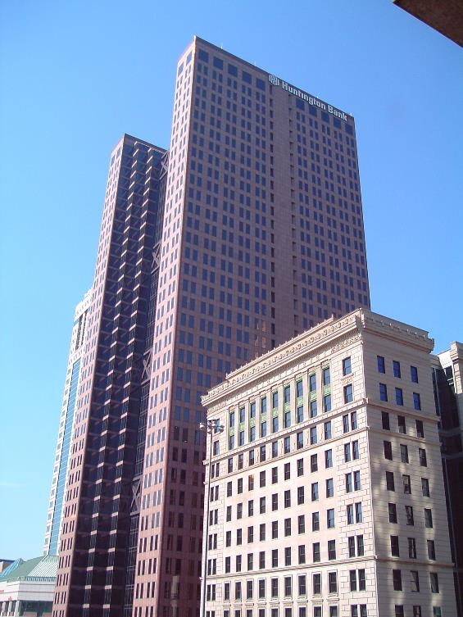
Bank Smart
Banks understand and use the concept: “No Stagnant Money”
Smart investors do what banks do
Move the Right amount of money… at the Right time - from one account to another account
Let it sit for the Right length of time

Slide 16
Banks “Sweep Accounts”
Every day at the close of business, banks “Sweep” the checking and savings accounts of all their clients
Banks use our money to earn interest for themselves while we sleep
They know money works 24 hours a day, 7 days a week, 365 days a year
Learn to Bank like a Bank

Slide 17
# 7 - Offset Accounts (OA)
Home Equity Lines of Credit
Personal Lines of Credit
Commercial Line of Credit
Secured Lines of Credit
Unsecured Lines of Credit
Checking/Savings Accounts
Some Insurance Products

Slide 18
OA – Basic Concept
$200,000
Offset Accounts
LOC
Savings
$15,000
Mortgage

Slide 19
10% to Pay Off 6%
$200,000
Borrow money from your OA
to pay down your 1st mortgage.
Transfer: $5000
$15,000
Mortgage
6%
Mortgage
HELOC
10%
Open–end
Line of Credit
Closed–end Loan

Slide 20
Interest & Time Savings
$200,000
$194,800
Future Mortgage
Interest Cancelled
$23,304
OA interest
Payment $41.67 for the Month
Eliminated
23
Payments
Mortgage
$15,000
$5,000

Slide 21
OA – Basic Concept with Float
$200,000
$194,800
$5,000
Paycheck
$4,000
Expenses
PAYMENT
CHARGES
HELOC
Credit Card
Skymiles
Rewards
Cash Back
Mortgage
$15,000
$5,000
$4,000
$4,000
$0
Pay Off
$0

Slide 22
Which One Pay-Off First?
The Program makes those tough decisions for you
$226,183
6.5%
Mortgage
$42,296
6.75%
Auto Loan
$27,753
6%
Trailer Loan
$21,538
7%
Lines of
Credit
$7,753
6.125%
College Debt
$4,309
6.125%
Furniture

Slide 23
What is Missing?
No one has the Systems to do it Themselves
No one has Time to do this on Their Own
Too Complicated to do Manually
Too Complex to Navigate
No Strategic Payoff
We Have The Answer

Slide 24
Technology has Caught-up
with Personal Finance
The World’s FIRST & ONLY Financial GPS

Slide 25
The Program Tells You
How much money to move?
(The exact dollar amount)
When to move it?
(The exact date)
From what account to what account?
(The most efficient accounts)
Calculates the Most Strategic
Mathematic Solution to
ZERO DEBT

Slide 26
Your Financial GPS
Looks at Every Aspect of Your Personal Debt
Amount Owed
Term of Each Debt
Interest Rate
Payment Amount
Income & Expenses

Slide 27
Your Financial GPS
When Unexpected Events Occur in Your Financial Journey
Medical Bills, Car Repairs, etc.
“Life Happens”
Your Money Max Account will Automatically
“Recalculate” Your Path to ZERO DEBT

Slide 28
#8 - Strategic Debt Payoff & Cash Flow
Strategic Debt Payoff
Checking
OA
Debts
Income
Funds Transfer
FT
Optimal Transfer Point
Income
Funds Transfer
Pay
Minimum Reserve
Critical Level

Slide 29
Monthly Budget
Monthly Living Expenses $2,800.90
Primary Mortgage $1,199.10
Total Living Expenses $4,000.00

Slide 30
Monthly Budget
Monthly “NET” Income $5,000.00
Total Living Expenses $4,000.00
Discretionary Income $1,000.00

Slide 31
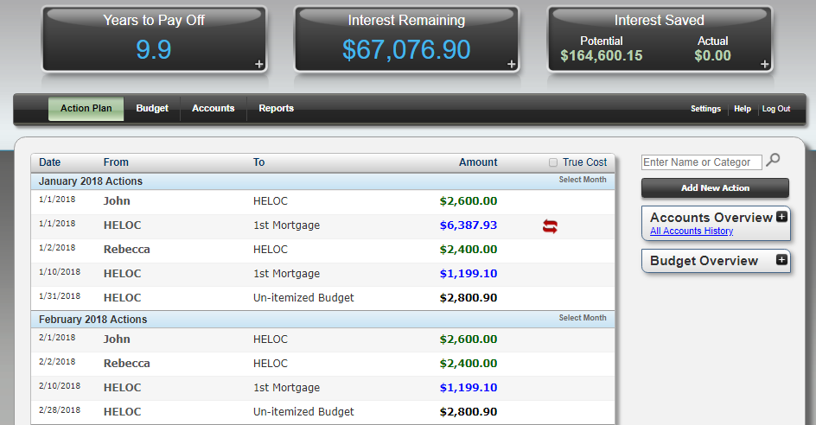
Starting Dashboard
Years to Pay Off
9.9
Interest Remaining
$67,076.90
Potential Interest Saved Actual
$164,600 0
HELOC 1st Mortgage $6,387.93

Slide 32
Interest Cancellation
 | Principal | Interest | Balance | Remaining
Month 1 | $199.10 | $1,000.00 | $199,800.90 | 359
Month 2 | $232.04 | $967.06 | $193,180.93 | 330
Month 2 | $200.10 | $999.00 | $199,600.80 | 358
What if we add $6,387.93 to principal?
$31.94
Principal
Jump:
HELOC Interest $44.90
Principal Jump $31.94
Difference $12.96
Cancelled
$29,215.98
Interest
Eliminated
29
Payments

Slide 33
Month 1
Offset Account
Start Balance: $0.00
Expenses: $4,000.00
Funds Transfer: $6,387.93
New Balance: $10,387.93
Income: $5,000.00
Ending Balance $5,387.93
Month 1
Ending Balance $5,432.83
+ $44.90
Interest
Cancelled
$29,215.98
Interest
Eliminated
29
Payments

Slide 34
Months 2 & 3
O.A. Balance: $5,432.83
Expenses: $4,000.00
$9,432.83
Income: $5,000.00
Ending Balance: $4,432.83
Month 2
Ending Balance: $4,469.77
+ $36.94
Interest
O.A. Balance: $4,469.77
Expenses: $4,000.00
$8,469.77
Income: $5,000.00
Ending Balance $3,469.77
Month 3
+ $28.91
Interest
Ending Balance $3,498.68

Slide 35
Month 4
O.A. Balance: $3,498.68
Expenses: $4,000.00
$7,498.68
Income: $5,000.00
Balance: $2,498.68
Funds Transfer: $4,231.62
Ending Balance: $6,730.30
Month 4
4-month total
Interest Paid:
$166.84
Ending Balance: $6,786.39
+ $56.09
Interest
Cancelled
$45,666.31
Interest
Eliminated
46
Payments

Slide 36
Month 7
O.A. Balance: $4,874.90
Expenses: $4,000.00
$8,874.90
Income: $5,000.00
Balance: $3,874.90
Funds Transfer: $3,911.04
Ending Balance: $7,785.94
Month 7
7-month total
Interest paid
$320.23
+ $64.88
Interest
Ending Balance: $7,850.82
Cancelled
$59,153.19
Interest
Eliminated
61
Payments

Slide 37
Amortization Schedule
 | principal | Interest | Balance | Remaining
Month 5 | $256.69 | $942.41 | $188,225.06 | 309
Month 6 | 257.97 | 941.13 | 187,967.09 | 308
Month 7 | 259.26 | 939.84 | 183,796.79 | 292
Month 8 | 280.12 | 918.98 | 183,516.67 | 291
Month 1 $199.10
Month 8 $280.12
$81.02
$20.86 Principal Jump
Eliminated
61
Payments
8 Month Total
Principal Jump
Cancelled
$59,153.19
Interest

Slide 38
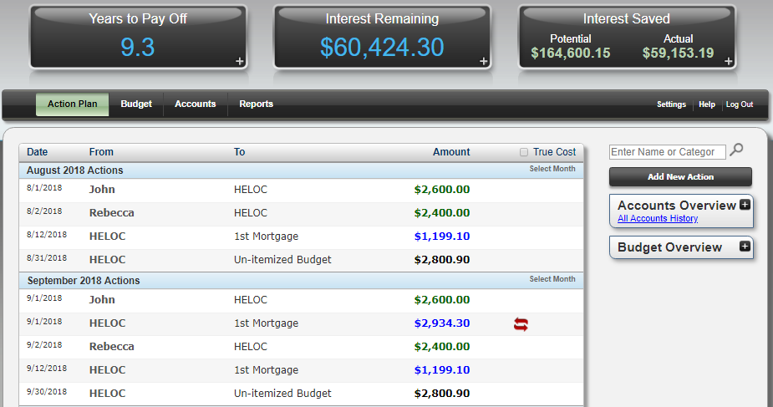
Dashboard After 7 Months
Years to Pay Off
9.3
Interest Remaining
$60,424.30
Potential Saved Actual
$164,600 $59,153
HELOC 1st Mortgage $2,934.30

Slide 39
How Do We Compare?
Conventional Plan | Money Max Account
New Mortgage:
Balance after 7 Months:
Time to Pay-Off:
Total Interest PAID:
$200,000
$200,000
5.7 Years
$183,922
$198,585 *
$183,796 *
30 Years
9.9 Years
$231,677 *
$67,077 *
Choose 1
Saved
$164,600
9.9 Years
30 Years
- 20 Years
* See Company Website for Details… Results Vary

Slide 40
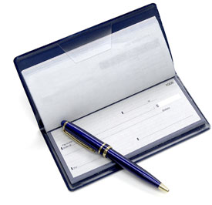
The Money Max Account
Home Equity Line of Credit
Personal Line of Credit
Commercial Line of Credit
Secured Line of Credit
Credit Card
Now works with just a
Checking & Savings Account

Slide 41
Checking & Savings Method
Strategic Debt Payoff
Checking
Savings
Debts
Funds Transfer
Optimal Transfer Point
High Reserve Line
FT
Income
Funds Transfer
Income
Pay
Minimum Reserve
Minimum Reserve

Slide 42
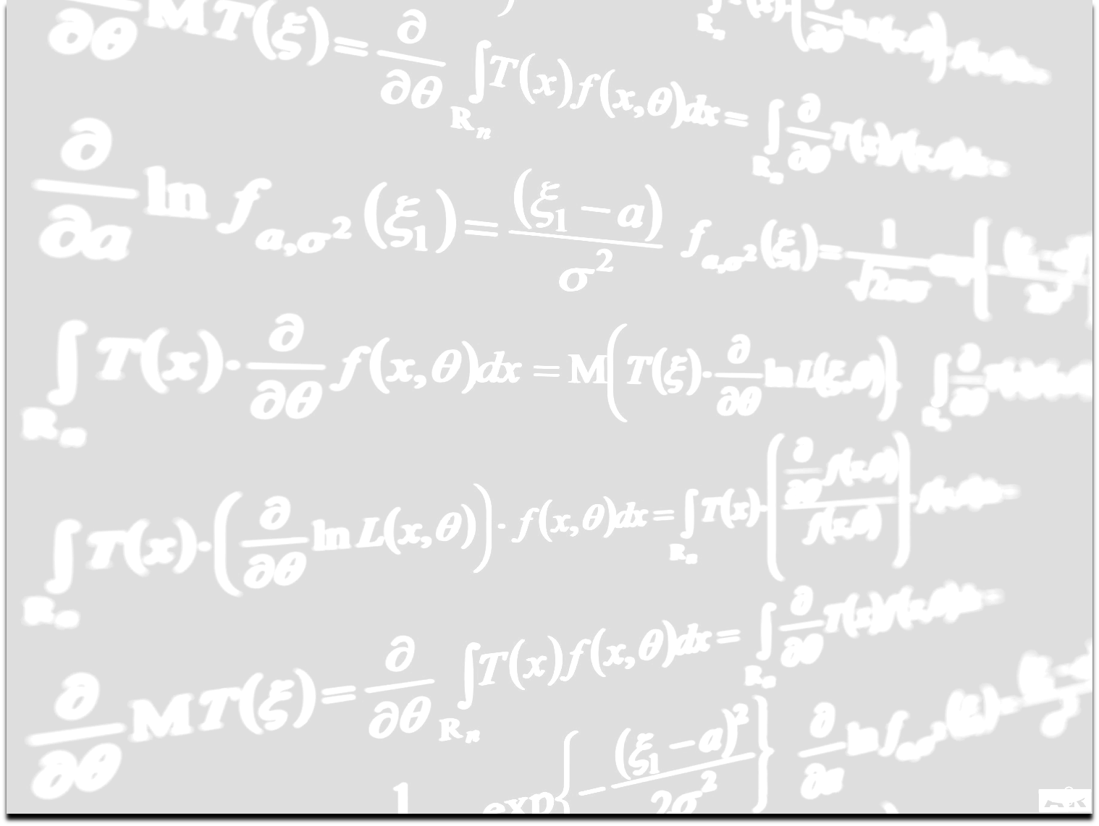
Backed by Science
The 1st Interactive Debt Elimination Program
Connects to over 13,000 Banks & Lenders
Web-based Connectivity and Security
Lifetime Program Updates at NO CHARGE
Mathematical Engines Driven by Complex Banking Algorithms and Systems
No Magic – Just Math

Slide 43
United Financial Freedom
Live Client Support
Live Chat
Live Training
Online Video Tutorials
Online Blog
Continuing Education

Slide 44
Corporate Commitment
Over
$19,000,000
in Development Cost

Slide 45
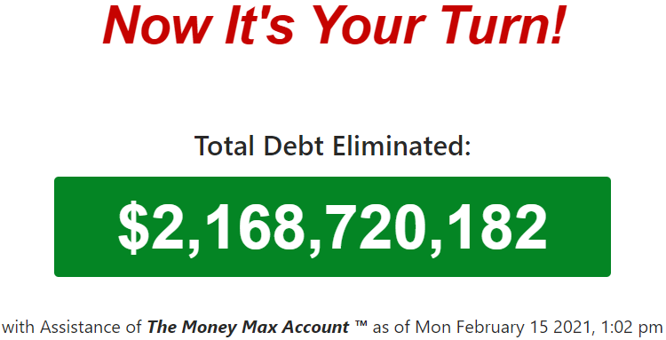
The Results Speak for Themselves
How many families need our message and product?
Do you want to leave a legacy of wealth or debt?
To date we have helped our clients payoff :
How would this impact your family?

Slide 46
We Are On A Mission!
We All Working Together as a TEAM
to
Convert Debt into Wealth
and
“Buy America Back One Family at a Time”

Slide 47
Achieving Your Financial Goals Begins with Debt Elimination
Ask the UFF Agent who invited you to run your FREE Savings Report

Slide 48
Get Your FREE Savings Report
I
I
Let the Numbers Do the Talking

Slide 50
United Financial Freedom
Money Max Account Presentation
“Buying America Back One Family at a Time”

